Slide 1
New eBuy Standards
BFS – Business & Financial Services

Slide 2
Benefits of New eBuy Standards
BFS
Standards will simplify PO/PR/DAPO entry in eBuy
Create quality historical purchasing data for:
Strategic Sourcing opportunities
What are we purchase?
How are we spending?
Who we are spending with?
Identify new catalogue/punch-out opportunities
Establish key supplier partnerships for campus requirements
Improve accuracy and efficiency of processing invoices for payment

Slide 3
What will change?
BFS
How we communicate with our supplier(s) when transacting
The way we enter PR’s and DAPO’s in eBuy
These common standards and formats allow the most effective utilization of automated processes
Good/Product(s)
Service(s)
Good/Product(s) & Service(s)

Slide 4
Supplier Communication
BAS
BFS – Business & Financial Services
A Division of Business & Administration Services (BAS)
BFS
Item identifier (Part #/Manufacturer #/SKU)
Proper good/service description
Agreed upon price
Unit of Measure (UOM)
Tax
Expected delivery/completion date
Freight or Shipping & Handling
Payment terms
What details should you request from the Supplier to confirm your order?
REMINDER: Suppliers are required to submit their invoices directly to Accounts Payable.

Slide 5
Supplier Communication
BAS
BFS – Business & Financial Services
A Division of Business & Administration Services (BAS)
BFS
Ask the Supplier how they will be invoicing?
Obtain a quote of the complete order
Request an email confirmation
Sales order/acknowledgement
DO NOT SIGN OR RETURN TO SUPPLIER
Performa invoice
Note: This is a quotation; not a payable invoice
Other
Explore and use Jaggaer catalogue/punch-out for your purchasing needs or the PCard
How do you obtain the information from the supplier?
REMINDER: Suppliers are required to submit their invoices directly to Accounts Payable.

Slide 6
eBuy & A/P Screen Shots
BAS
BFS
BFS – Business & Financial Services
A Division of Business & Administration Services (BAS)
eBuy Entry
AP View
REMINDER: AP’s View Description is limited to 29 characters and that is why a Catalog # is very important

Slide 7
PO Types |Standard Formats
BAS
BFS
BFS – Business & Financial Services
A Division of Business & Administration Services (BAS)
PO Type | Description | Catalog # | Code = Catalog #
Good/Product(s) | Noun, Modifier | Part #/Manufacturer #/SKU | N/A
Service(s) | SVC, Type | N/A | SVC
Good/Product(s) & Service(s) | Line 1: Noun, Modifier Line 2: SVC, Type | Line 1: Part #/Manufacturer #/SKU Line 2: N/A | Line 1: N/A Line 2: SVC
NOTE: No longer add $0.00 lines for purchase details; all comments should be added in the Description underneath the PURPOSE of the good/service.

Slide 8
Payment Types
BAS
BFS
BFS – Business & Financial Services
A Division of Business & Administration Services (BAS)
Payment Type | Definition | Instruction
Progressive | Partial payments made at different stages of work (or delivery), instead of making one full payment on completion | Catalog Number should indicate the payment increment Code: PYMT #1,2,3….
Multi-Year | A contract/agreement for the purchase of services for more than 1 year | Full duration of the agreement should be reflected in the PO Code: PYMT YR #1, 2, 3 …
Material/Labor | Material: Components used to produce a product/render a service Labor: Human efforts utilized to create a product/service. | Material should be presented as a separate line from labor due to taxation Material: TAXABLE | Labor: NON-TAXABLE
Deposit | Payment due prior to execution of order | Approval required AVOID AT ALL COST
Freight | Transport of goods by truck, train, ship, or aircraft | Any freight charge above $250 requires separate line NON-TAXABLE
Shipping / Handling | A combination of shipping charges and labor for packing. | Shipping/Handling should be presented as a separate line TAXABLE
Taxation | Tax is based on the delivery location | If tax code is not available in eBuy then a separate line must be created for payment of tax. Code: TAX NOTE: Lines effected by the tax rate should be noted in the Description: Purchase Details of the tax line

Slide 9
PO Codes | Standard Formats
BAS
BFS
BFS – Business & Financial Services
A Division of Business & Administration Services (BAS)
The below codes should be entered in the Catalog # field when a Part # is NOT available:
Codes | Description
SVC | Service(s)
PYMT #1, 2, 3 … | Progressive Payment
PYMT YR #1, 2, 3 … | Multi-Year Payment
DEP | Deposit
TAX | Shipping/Handling tax
NOTE: No longer add $0.00 lines for purchase details; all comments should be added in the Description underneath the PURPOSE of the good/service.

Slide 10
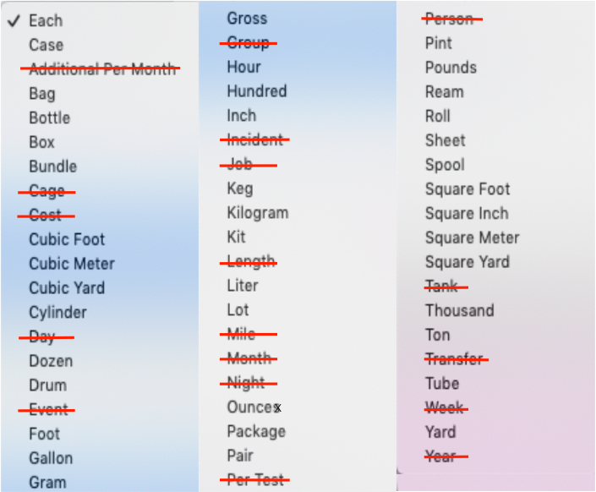
Unit of Measure (UOM) - Use
BAS
BFS
BFS – Business & Financial Services
A Division of Business & Administration Services (BAS)

Slide 11
Understanding Discounts
BAS
BFS
BFS – Business & Financial Services
A Division of Business & Administration Services (BAS)
Payment Term:
Payment Term (i.e. 2%/10 Net 30 days) is a Header entry and taken at the time the invoice is being processed for payment.
It should NOT be calculated or reflected in the PO line item cost.
Reduced/Negotiated Price/Cost:
Enter line item discounted price on the PO (Calculate prior to your entry).
DO NOT enter a (-)negative line to offset discount purchase price.
Total Order line discounts should be questioned.

Slide 12
eBuy |Standard Formats
Examples
BFS – Business & Financial Services
A Division of Business & Administration Services (BAS)

Slide 13
Good/Product(s) | Standard Format
BAS
BFS
BFS – Business & Financial Services
A Division of Business & Administration Services (BAS)
Quantity:
Use selling UOM
Unit of Measure:
Refer to the UOM Symbols handout
Description:
Part 1: Noun, Modifier
Part 2: PURPOSE: Explanation
Part 3: Purchase Details
Catalog Number:
Part #/Manufacturer #/SKU
Unit Price:
$USD MUST match the UOM for each line item based on the invoice/quote received from the supplier
Taxable:
Generally all good(s) are taxable; research good(s) may be permitted to reduced sales tax terms if applicable
Expected Delivery:
Expected delivery date of item(s)
Relate to UOM
Noun, Modifier
PURPOSE: Use/Application Purchase Details
Part #/Manufacturer #/SKU
$USD
MM/DD/YYYY

Slide 14
Good/Product(s) | Example 1
BAS
BFS
BFS – Business & Financial Services
A Division of Business & Administration Services (BAS)
Scenario #1
Department: ITS
Lease for 20 Dell laptops
7 (Model 7390)
13 (Model 5490)
Lease agreement: 4 years (48 months)
Payment Frequency: Annual
Estimated Delivery: 1/09/2019
Estimated delivery date: Jan. 09, 2018

Slide 15
Year 1
BAS
BFS
Good/Product(s) | Example 1 – Sample Quiz
Line #1
Line #2

Slide 16
Year 1
BAS
BFS
Good/Product(s) | Example 1 - SampleAnswer
Line #1
Line #2
7
13
Laptop, Dell, Latitude
PURPOSE: ITS Master Lease Agreement with Dell Lease agreement: 4 years (48 months)
Payment Frequency: Annual
Laptop, Dell, Latitude
PURPOSE: ITS Master Lease Agreement with Dell Lease agreement: 4 years (48 months)
Payment Frequency: Annual
7390 – PYMT YR #1
5490 – PYMT YR #1
1,599.63
1,231.22
01/09/2019
01/09/2019

Slide 17
Service(s) | Standard Format
BAS
BFS
BFS – Business & Financial Services
A Division of Business & Administration Services (BAS)
Quantity:
For Non-Progressive Payments : 1
Unit of Measure:
Lot
Hour
Description:
Part 1:
SVC, Temp
SVC, Security
SVC, Legal
SVC, Install
SVC, Maint
SVC, Prof...
Part 2: PURPOSE: Explanation
Part 3: Purchase Details
Catalog Number:
SVC
Unit Price:
$USD MUST match the UOM for each line item based on the invoice/quote received from the supplier
Taxable:
Generally service(s) are not taxable however apply appropriate taxes based upon the purchase conditions. Ensure that labor/installation services are featured as separate line items and represented as NON-TAXABLE
Expected Delivery:
Expected completion of service(s) rendered
1
SVC, Type
PURPOSE: Explanation
Purchase Details
SVC
$USD
MM/DD/YYYY

Slide 18
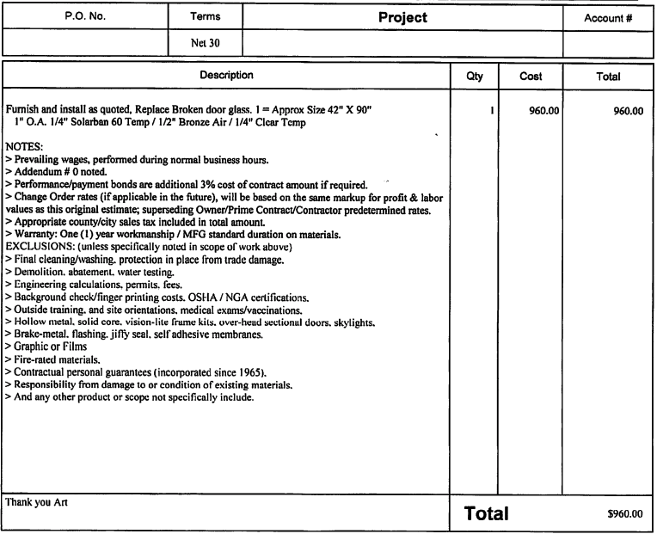
Service(s)| Example 2
BAS
BFS
BFS – Business & Financial Services
A Division of Business & Administration Services (BAS)
Scenario #2
Department: Student Recreation Center
Replacement of broken glass door
Estimated Delivery: 3/28/2019

Slide 19
Service(s)| Example 2 – Sample Quiz
BAS
BFS
BFS – Business & Financial Services
A Division of Business & Administration Services (BAS)

Slide 20
Service(s)| Example 2 - Sample Answer
BAS
BFS
BFS – Business & Financial Services
A Division of Business & Administration Services (BAS)
1
SVC, Repair, Door, Glass
PURPOSE: Replace Broken door glass; CookWell Kitchen @ Student Rec Center (SRC) South
1 = Approx Size 42" X 90"
1" O.A. 1/4" Solarban 60 Temp / 1/2" Bronze Air / 1/4" Clear Temp
NOTES: prevailing wages, performed during normal business hours.
Contractor shall furnish and utilize manufacturer's specified materials and procedures for all installations. Coordinate and furnish an installation schedule with the University prior to start of work. Installation start date shall be determined and mutually agreeable between University contact and Vendor. Warranty: One(1) year workmanship/ MFG standard duration on materials.
SVC
960.00
03/28/2019

Slide 21
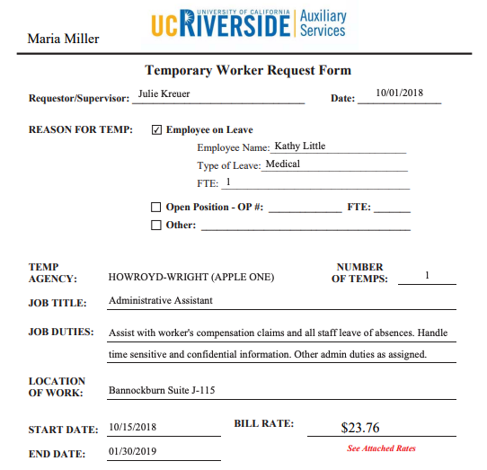
Service(s) | Example 3
BAS
BFS
BFS – Business & Financial Services
A Division of Business & Administration Services (BAS)
Temp.
Minnie Mouse
Donald Duck
Scenario #3
Department: Auxilary Services
Temp Name: Minnie Mouse
Job Title: Top Chef
Location: Disneyland, Club 33
Bill Rate: $30.24
Hours Worked: 159.5
Start Date: 10/15/2018 - 1/30/2019
Top Chef
Cook exceptional meals for Club 33 guests
Club 33
$30.24

Slide 22
BAS
BFS
BFS – Business & Financial Services
A Division of Business & Administration Services (BAS)
Service(s) | Example 3 Sample Quiz
Temp.

Slide 23
BAS
BFS
BFS – Business & Financial Services
A Division of Business & Administration Services (BAS)
Service(s) | Example 3 Sample Answer
Temp.
159.5
Hour
SVC, Temp. M. Mouse
PURPOSE:; Temporary Top Chef
Pay Rate: $30.24 Start Date: 10/15/2018 End Date: 01/30/2019 Location: Disneyland, Club 33 Contact: Donald Duck Telephone: 951-222-2222
SVC
30.24
01/30/2019

